Slide 1
Containers Orchestration
SE489: DevOps Engineering

Slide 2
Outline
Why Do we need Container Orchestration?
Container Orchestration
Container Orchestration Tools
What is Kubernetes and How it works
Kubernetes Use Case
Kubernetes Architecture

Slide 3
Why Do we need Container Orchestration?

Slide 4
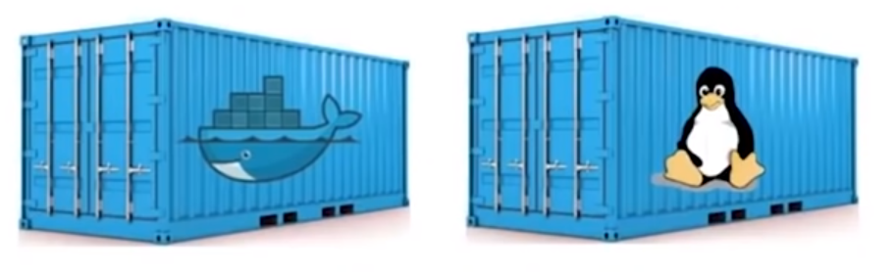
Containers are Good…
Both Linux Containers and Docker Containers
Isolate the application from the host
FASTER, RELIABLE, EFFICIENT, LIGHTWEIGHT, AND SCALABLE

Slide 5
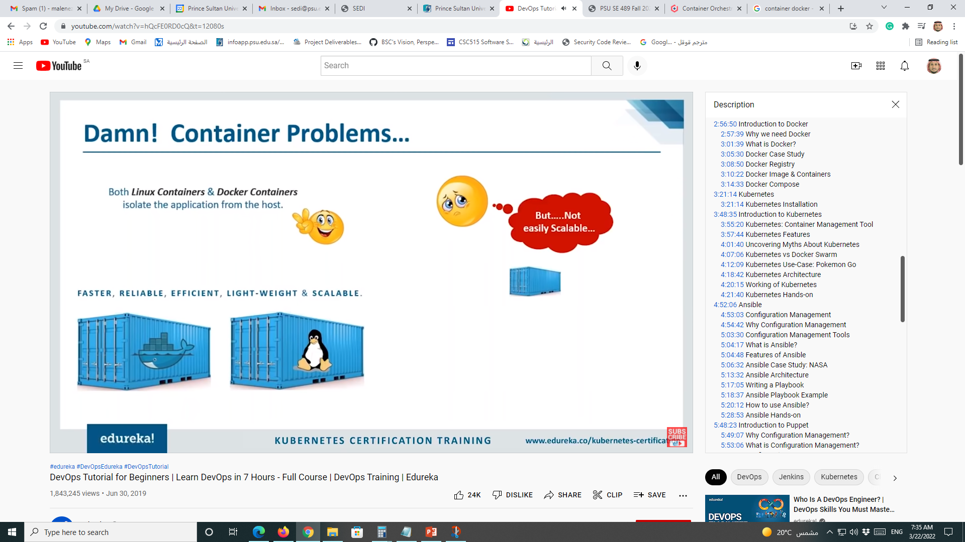
Containers Problems!
Both Linux Containers and Docker Containers
Isolate the application from the host
Not easily Scalable
FASTER, RELIABLE, EFFICIENT, LIGHTWEIGHT, AND SCALABLE

Slide 6
Containers Problems!
Both Linux Containers and Docker Containers
Isolate the application from the host
Not easily Scalable
FASTER, RELIABLE, EFFICIENT, LIGHTWEIGHT, AND SCALABLE

Slide 7
Problems with Scaling up Containers
Containers could communicate with each other
Containers had to be deployed appropriately
Containers had to be managed carefully
Auto scaling was not possible
Distributing traffic was still challenging
It was not Scalable
1
2
3
4
5

Slide 8
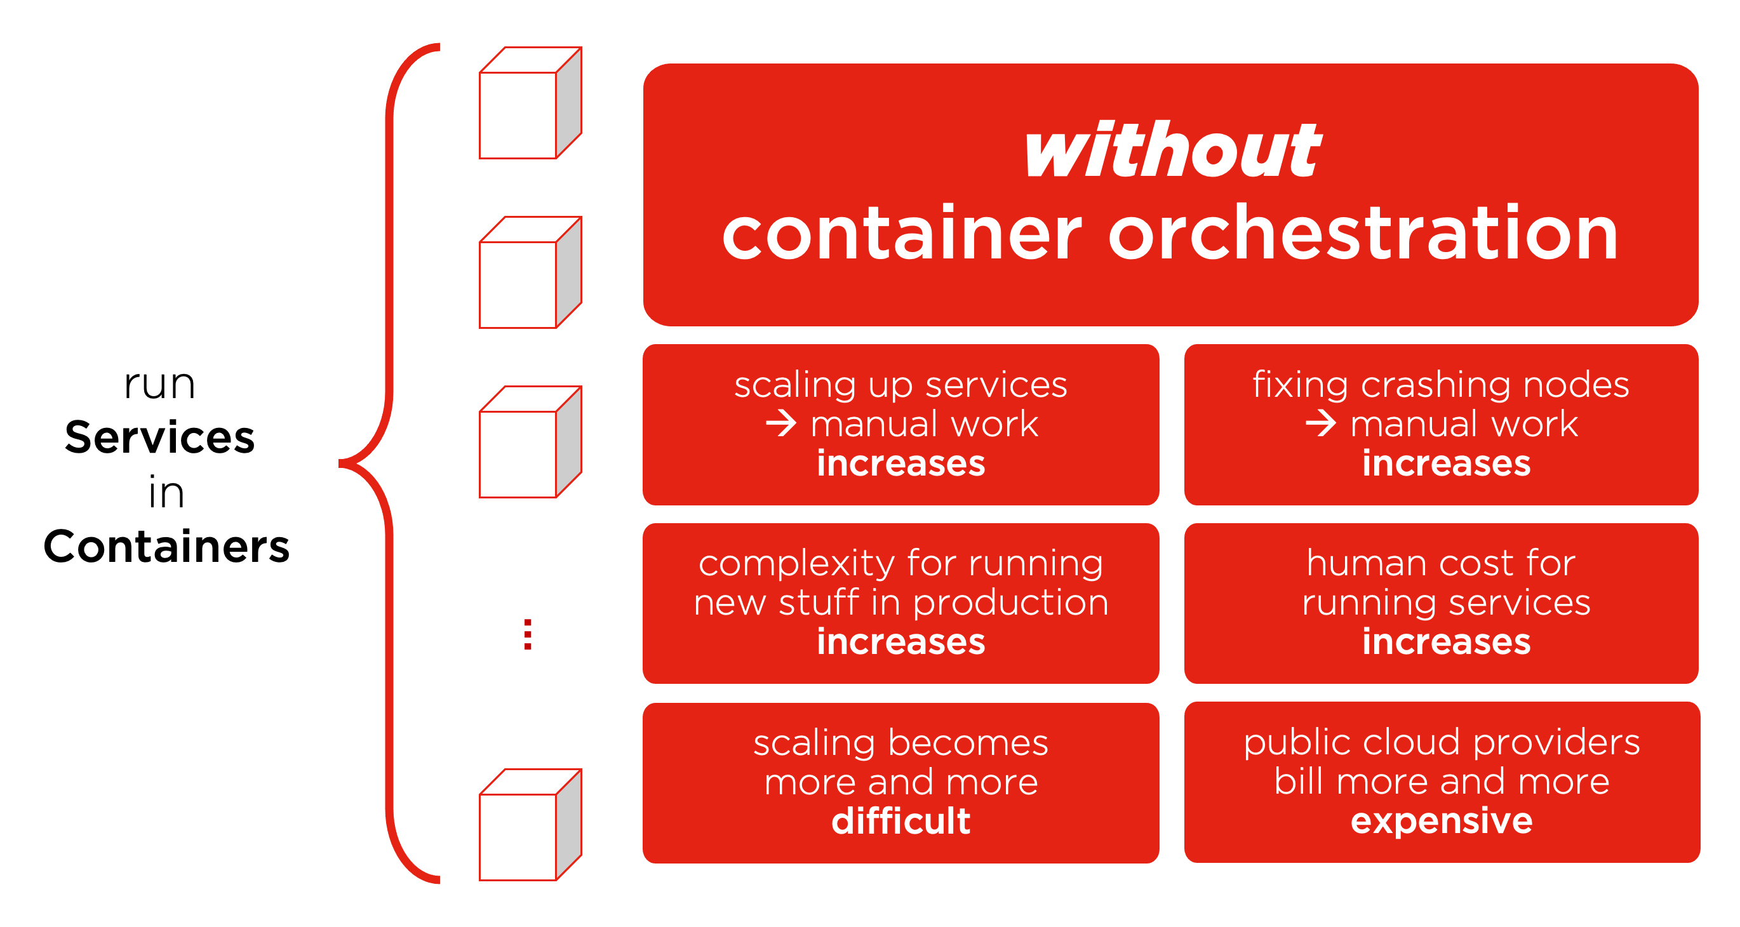
Containers Without Orchestration

Slide 9
Container Orchestration

Slide 10
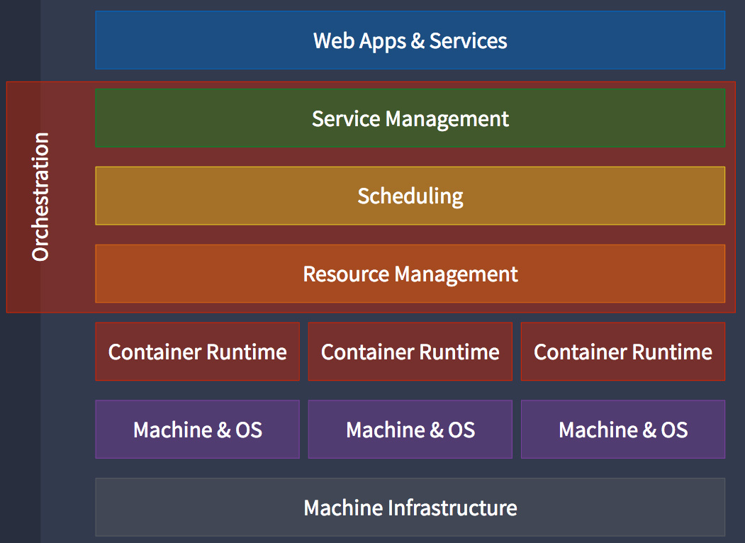
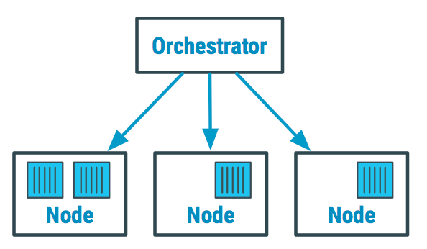
Container Orchestration
Container orchestration automates and simplifies provisioning, and deployment and management of containerized applications.

Slide 11
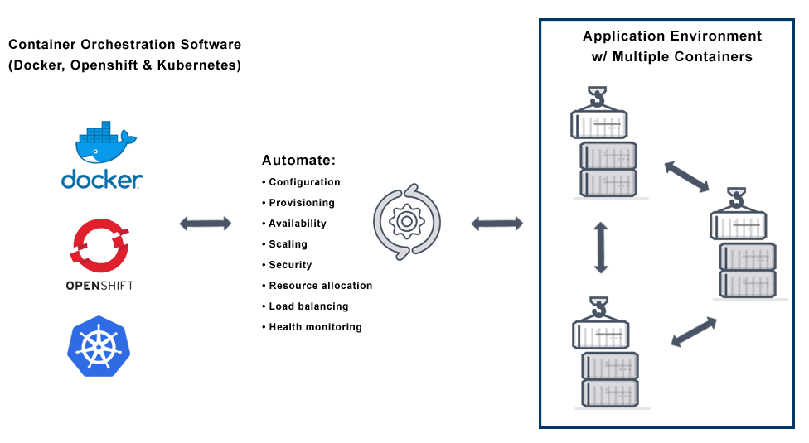
Container Orchestration
Container orchestration is the automatic process of managing or scheduling the work of individual containers for applications based on microservices within multiple clusters.
The widely deployed container orchestration platforms are based on open-source versions like Kubernetes, Docker Swarm or the commercial version from Red Hat OpenShift.

Slide 12
Container Orchestration
Fault-tolerance
On-demand scalability
Optimal resource usage
Auto-discovery to automatically discover and communicate with each other
Accessibility from the outside world
Seamless updates/rollbacks without any downtime.

Slide 13
Why Do We Need Container Orchestration?
Container orchestration is used to automate the following tasks at scale:
Configuring and scheduling of containers
Provisioning and deployments of containers
Availability of containers
The configuration of applications in terms of the containers that they run in
Scaling of containers to equally balance application workloads across infrastructure
Allocation of resources between containers
Load balancing, traffic routing and service discovery of containers
Health monitoring of containers
Securing the interactions between containers.

Slide 14
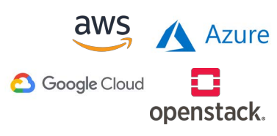
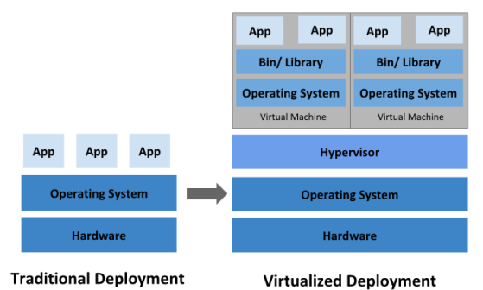
Cloud Orchestration
Infrastructure-as-a-Service (IaaS)
Provisioning virtual machines from a cloud service provider (CSP)

Slide 15
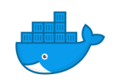
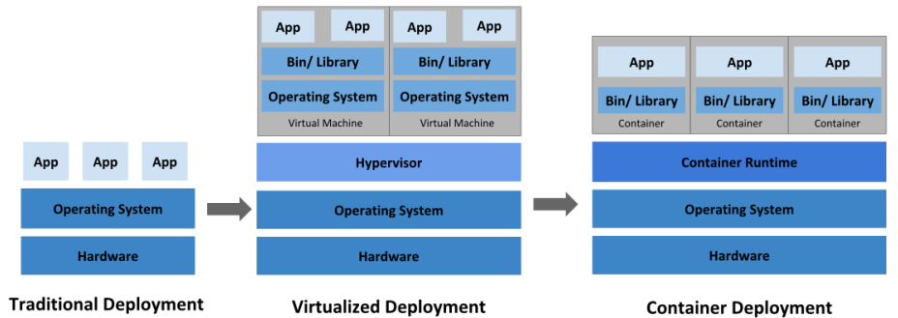
Container Orchestration
Application containers
Lightweight OS-virtualisation
Application packaging for portable, reusable software

Slide 16
Container Orchestration Tools

Slide 17
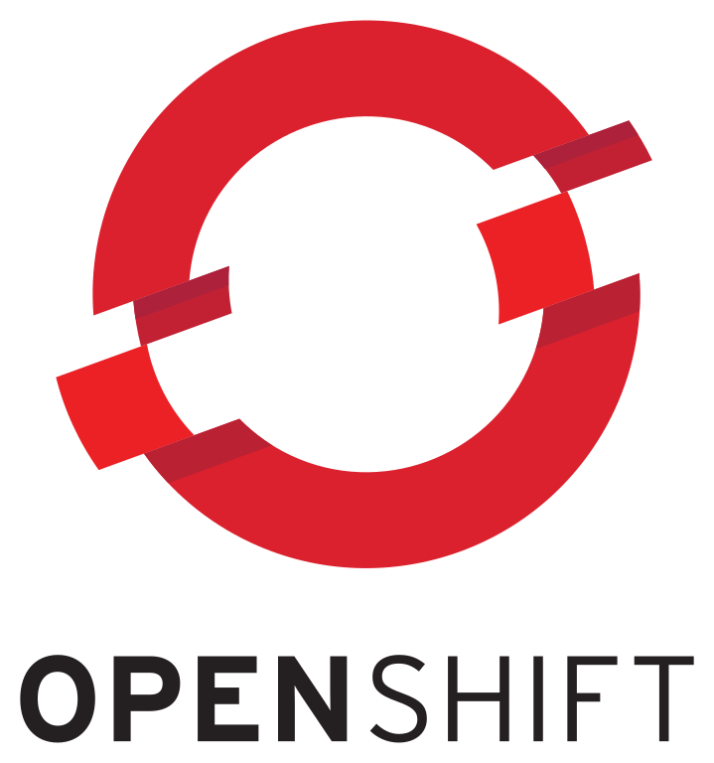
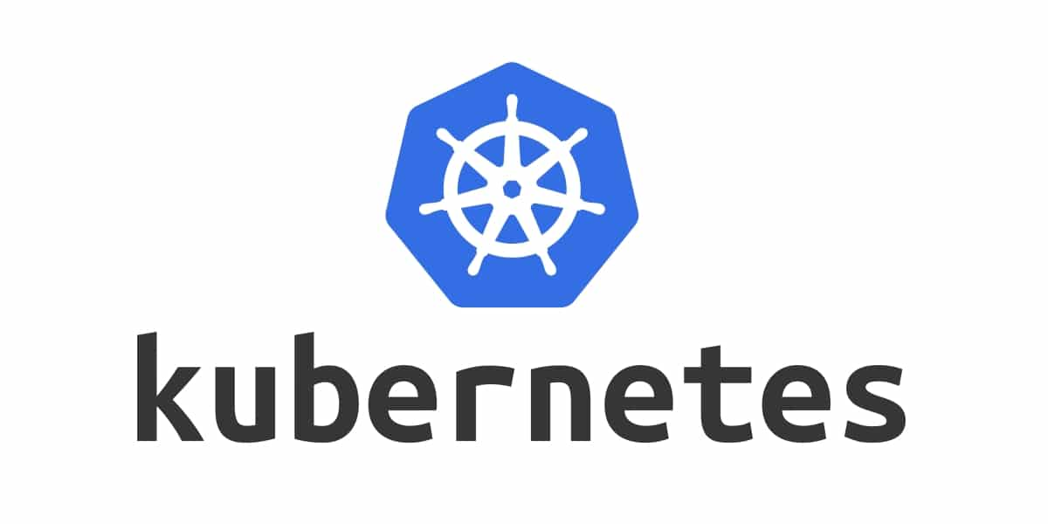
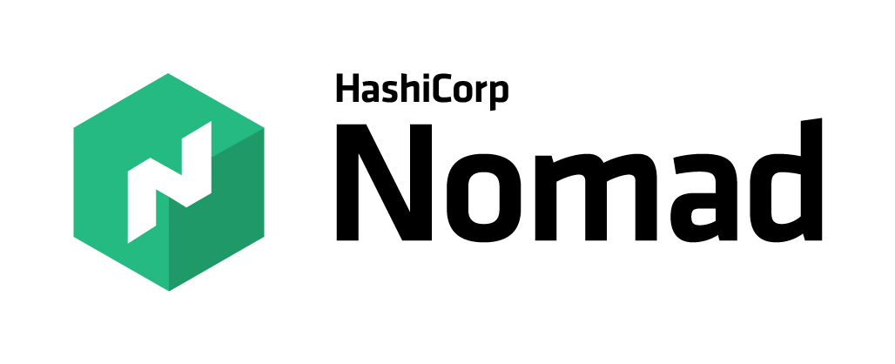
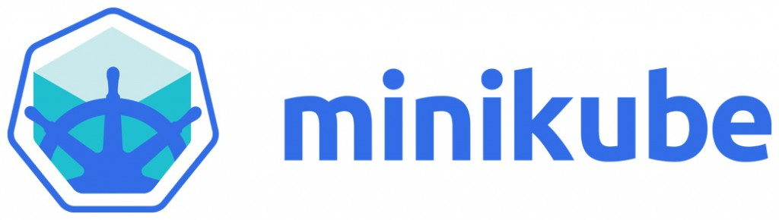

Container Orchestration Tools

Slide 18
What is Kubernetes and How it works

Slide 19
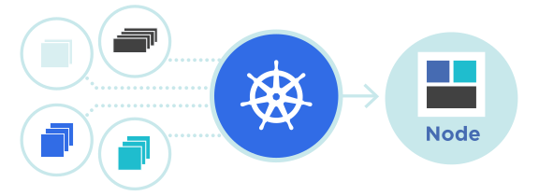
Kubernetes
Kubernetes is an open-source container management tool which automates container deployment, container (de)scaling and container load balancing
Benefits (Works with all cloud vendors (Public, Private (on-premises), and Hybrid))
More about Kubernetes
Developed by Google and written in Golang with a huge community
Can group ‘n’ containers into one logical unit for managing and deploying them

Slide 20
Kubernetes
Kubernetes is an open source container orchestration engine for automating deployment, scaling, and management of containerized application.
Originally an open source project launched by Google and now part of the Cloud Native Computing Foundation (CNCF).
Kubernetes is highly extensible and portable
Kubernetes is considered highly declarative
Kubernetes initial release (7 June 2014)
Releases every 3 months

Slide 21
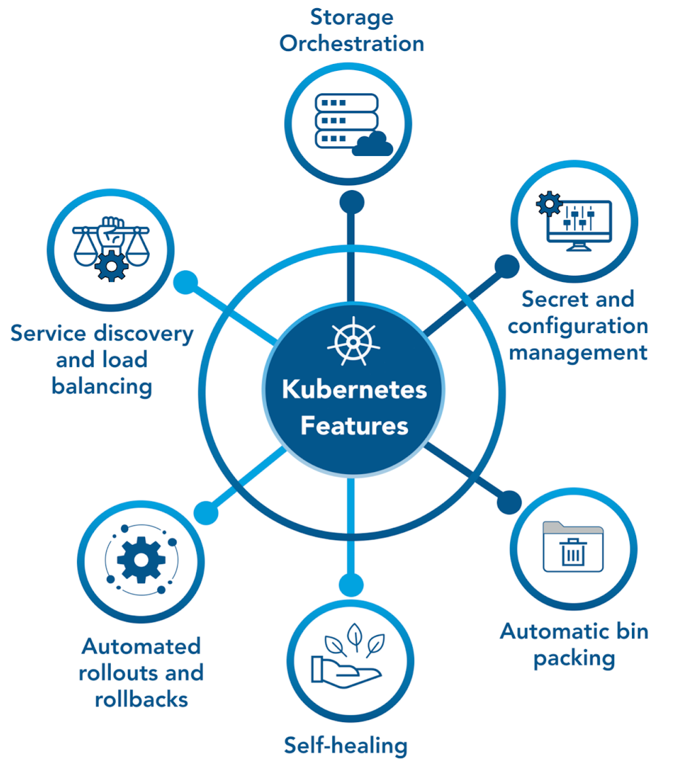
Kubernetes Features

Slide 22
Kubernetes Myths
Kubernetes is not:
To be compared with Docker
For containerizing apps
For apps with simple architecture
Kubernetes is actually:
Robust and reliable
A container orchestration platform
A solution for scaling up Containers
Backed by huge community
X
√

Slide 23
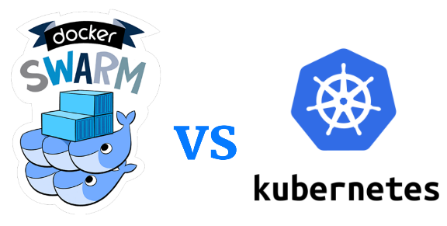
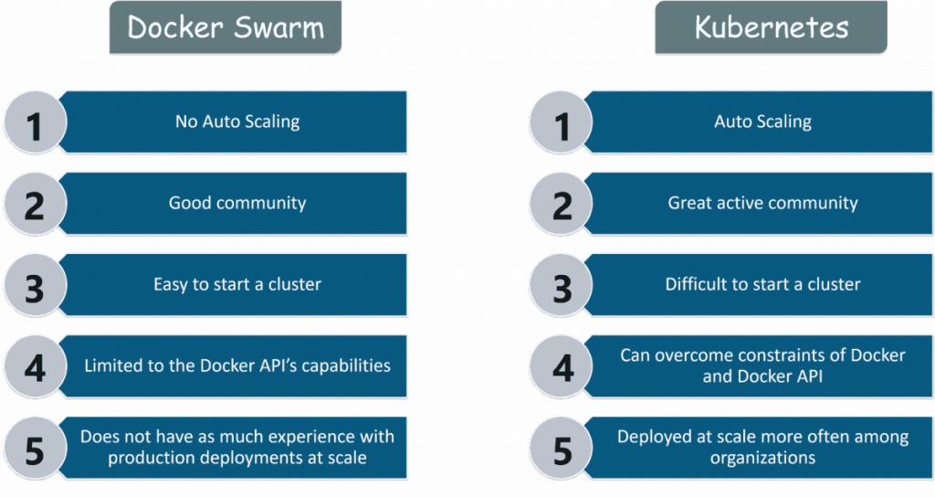
Kubernetes vs Docker Swarm

Slide 24
Kubernetes vs Docker Swarm
Features | Docker Swarm | Kubernetes
Installation and Cluster Configuration | Easy and Fast | Complicated and Time-consuming
GUI | Not Available | Available
Scalability | Scaling up is faster than K8S; but cluster strength is not as robust | Scaling up is slower but guarantees stronger cluster state
Load Balancing | Built-in load balancing technique | Requires manual service configuration
Updates and Rollback | Progressive updates and service health monitoring | Process scheduling to maintain services while updating
Data Volumes | Can be shared with any container | Only shared with containers in the same Pod
Logging and Monitoring | Only 3rd party logging and monitoring tools | Built-in logging and monitoring tools

Slide 25
Kubernetes Use Case

Slide 26

Kubernetes Use Case
Pokemon Go is an augmented reality game developed by Niantic for Android and iOS devices
Key Stats:
500+ million downloads, 20+ million daily active users
Initially only launched in NA, Australia and New Zeeland
Inspired users to walk over 5.4 billion miles in a year
Surpassed engineering expectations by 50 times

Slide 27
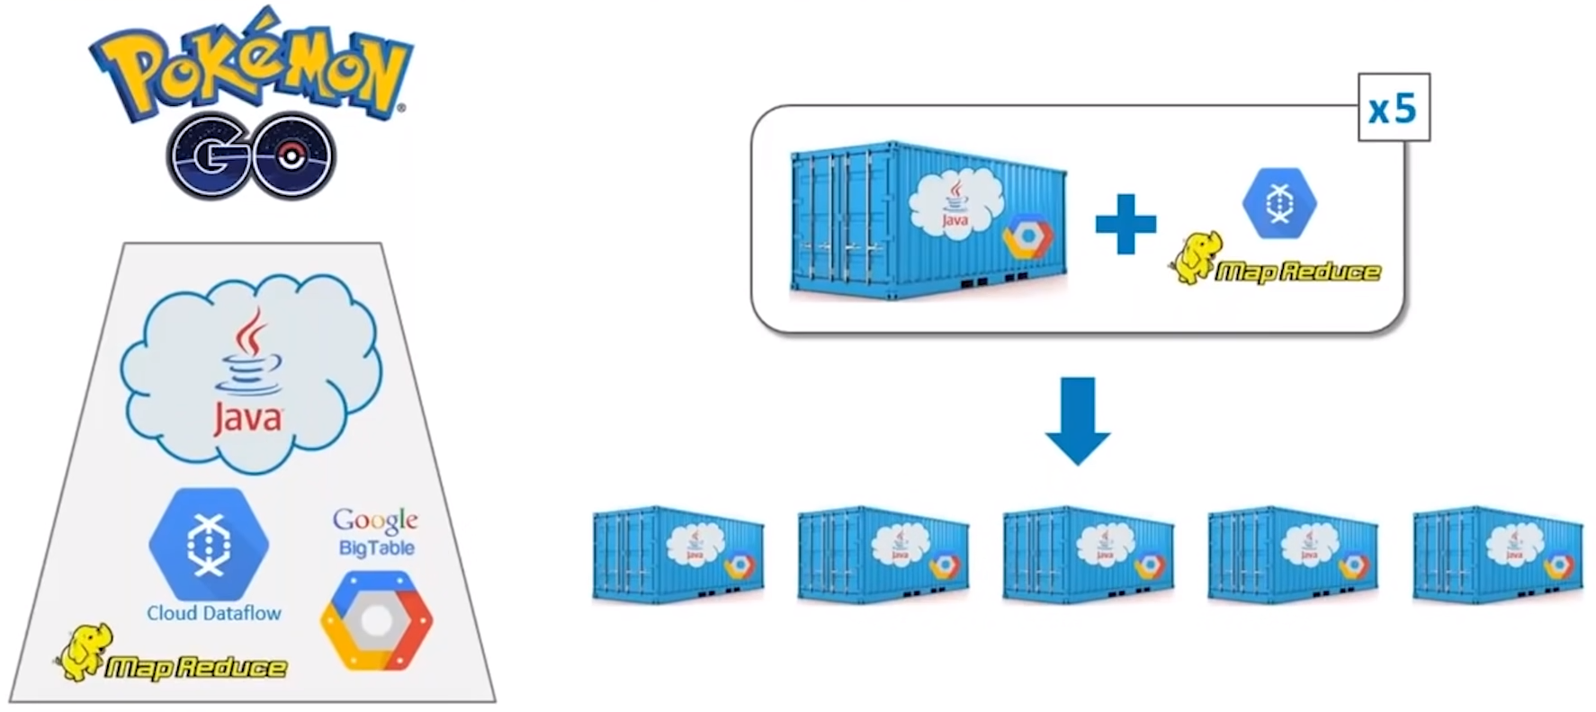
Backend Architecture

Slide 28
MapReduce & Cloud Dataflow for scaling up

Slide 29
Easy Scaling of Containers using Kubernetes

Slide 30
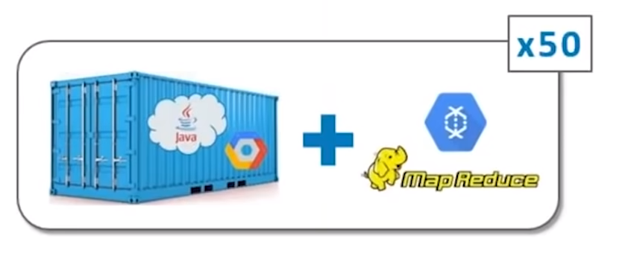
Easy Scaling of Containers using Kubernetes
Challenge
Biggest challenge fro most applications is horizontal scaling
For Pokemon Go, vertical scaling was an also a major challenge, because of real-time activity in gaming environment from millions of users
Niantic were prepared for traffic disasters of up to x5 times
Solution
Thanks to Kubernetes, Niantic were able to handle x50 times traffic

Slide 31
Kubernetes Architecture

Slide 32
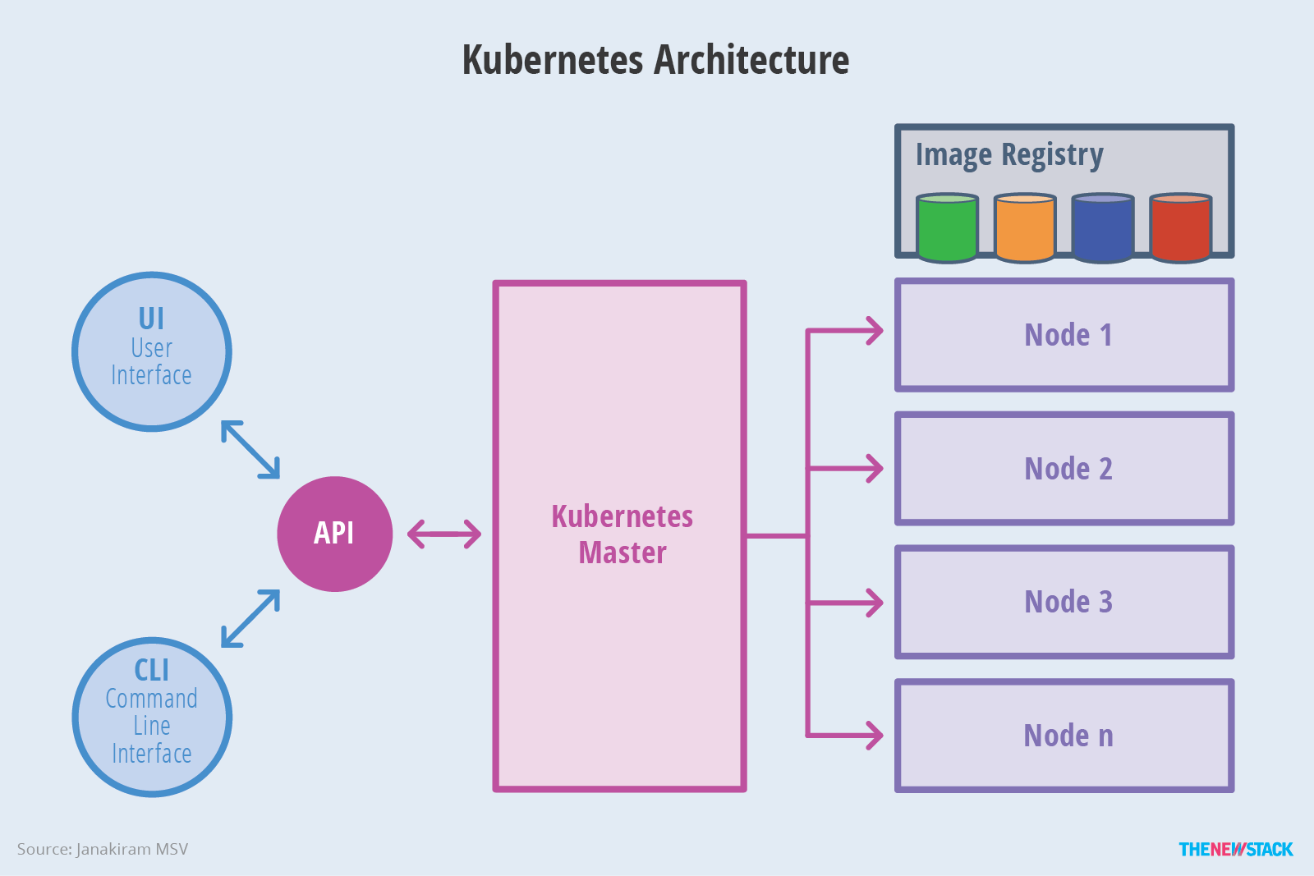
Kubernetes Architecture

Slide 33
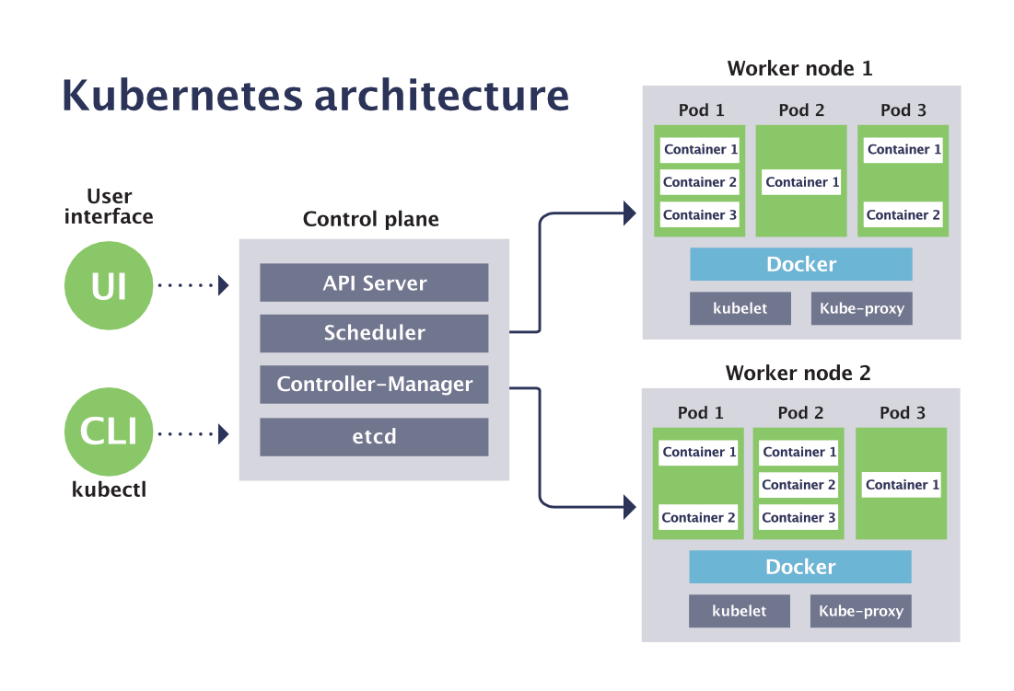
Kubernetes Architecture

Slide 34
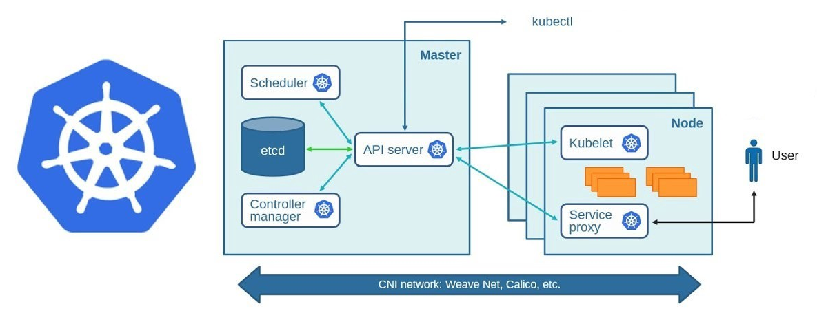
Kubernetes Architecture

Slide 35
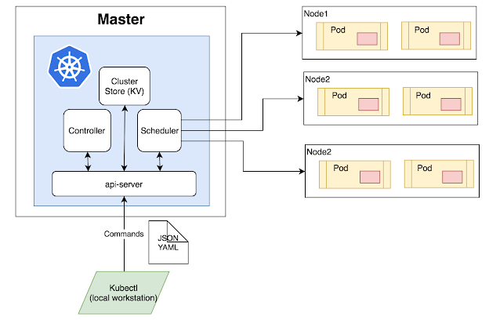
Kubernetes Components
Cluster:
A collection of hosts(servers) that aggregates their available resources.
Master:
A collection of components which make up the control panel of Kubernetes.
Node:
A single host which is capable of running on a physical or virtual machine.
Namespace:
A logical cluster or environment.

Slide 36
Kubernetes Components
When you deploy Kubernetes, you get a cluster.
A Kubernetes cluster consists of a set of worker machines, called nodes, that run containerized applications.
Every cluster has at least one worker node;
The worker node(s) host the Pods that are the components of the applications.
The master manages the worker nodes and the Pods in the cluster

Slide 37
Kubernetes Architecture
The master is responsible for:
exposing the Kubernetes (REST) API,
scheduling the applications,
managing the cluster,
directing communications across the entire system,
monitoring the containers running in each node as well as the health of all the registered nodes.
The nodes that are responsible for scheduling and running the containerized applications
Container images, which act as the deployable artifacts, must be available to the Kubernetes cluster through a private or public image registry.

Slide 38
Kubernetes Master
The Kubernetes master runs the following components that form the control plane:
API server: the front-end for the Kubernetes control plane that exposes the Kubernetes API
kube-apiserver
designed to scale horizontally
etcd: is a persistent, lightweight, distributed key-value data store that maintains the entire state of the cluster at any given point of time
scheduler: watches for newly created Pods with no assigned node, and selects a node for them to run on
kube-scheduler
controller: control loop that watches the shared state of the cluster through the apiserver and makes changes attempting to move the current cluster state to the desired cluster state

Slide 39
Kubernetes Nodes
Node components run on every node, maintaining running pods and providing the Kubernetes runtime environment.
Kubernetes Nodes components:
kubelet: agent that makes sure that containers are running in a Pod.
kube-proxy: implemented as a network proxy and a load balancer.
It routes traffic to the appropriate container based on its IP address and the port number of the incoming request.
Part of the Kubernetes Service concept.
container runtime: the software that is responsible for running containers.
Kubernetes supports several container runtimes:
Docker,
containerd,
CRI-O,
any implementation of the Kubernetes CRI (Container Runtime Interface).

Slide 40
Kubernetes Object
Kubernetes objects are persistent entities provided by Kubernetes for deploying, maintaining, and scaling applications.
Kubernetes uses these entities to represent the state of your cluster.
The objects can describe:
What containerized applications are running (and on which nodes)
The resources available to those applications
The policies around how those applications behave, such as restart policies, upgrades, and fault-tolerance
To work with Kubernetes objects (i.e., to create, modify, or delete them) you'll need to use the Kubernetes API. When you use the kubectl command-line interface, for example, the CLI makes the necessary Kubernetes API calls for you.

Slide 41
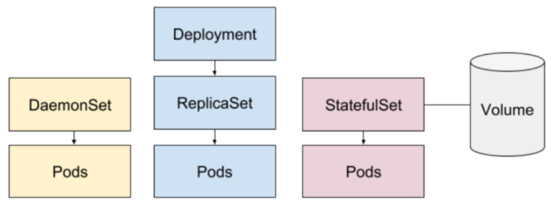
Basic Kubernetes Objects
Pod
Deployment, ReplicaSet
DaemonSet
StatefulSet
Service
Secret

Slide 42
Pods
Pods are the smallest deployable units of computing that you can create and manage in Kubernetes.
A Pod is a group of one or more containers, with shared storage/network resources, and a specification for how to run the containers.
A Pod's contents are always co-located and co-scheduled.
To create and manage multiple Pods, Kubernetes defines multiple resource types:
Deployment
StatefulSet
DaemonSet

Slide 43
Deployment
Deployment: represents a set of multiple, identical Pods with no unique identities.
It runs multiple replicas Pods and automatically replaces any instances that fail or become unresponsive.
Deployments ensure that one or more instances of Pods are available to serve user requests.
PodTemplates are specifications for creating Pods, and are included in resource objects such as Deployment object.
A ReplicaSet is the next-generation of ReplicationControllers
It ensures that a specified number of pod replicas are running at any given time.

Slide 44
Pod Management
StatefulSet: manages deployment and scaling of a set of Pods, with durable storage and persistent identifiers for each pod.
Unlike a Deployment, a StatefulSet maintains a sticky identity for each of its Pods.
DaemonSet: ensures that all (or some) nodes run a copy of a Pod.
As nodes are added to the cluster, Pods are added to them.
As nodes are removed from the cluster, those Pods are garbage collected.
Deleting a DaemonSet will clean up the Pods it created.

Slide 45
Controller
Controllers are control loops that watch the state of the cluster, then make or request changes where needed.
A controller tracks at least one Kubernetes resource object.
The controller(s) for that resource are responsible for making the current state come closer to that desired state (specified in the spec field).
Kubernetes comes with a set of controllers that run inside the kubecontroller-manager
The Deployment controller is an example of controller that come as part of Kubernetes itself ("built-in" controllers).

Slide 46
Service
The services model relies upon the most basic, though most important, aspect of services: discovery.
a Service is an abstraction which defines a logical set of Pods and a policy by which to access them.
The set of Pods targeted by a Service is usually determined by a selector.
Services ensure that traffic is always routed to the appropriate Pod within the cluster, regardless of the node on which it is scheduled.
Each service exposes an IP address, and may also expose a DNS endpoint, both of which will never change.
Internal or external consumers that need to communicate with a set of pods will use the service’s IP address, or its more generally known DNS endpoint.

Slide 47
Secret
Secrets are secure objects which store sensitive data, such as passwords, OAuth tokens, and SSH keys, in your clusters.
Storing sensitive data in Secrets is more secure than plaintext in Pod specifications.
Using Secrets gives you control over how sensitive data is used, and reduces the risk of exposing the data to unauthorized users.

Slide 48
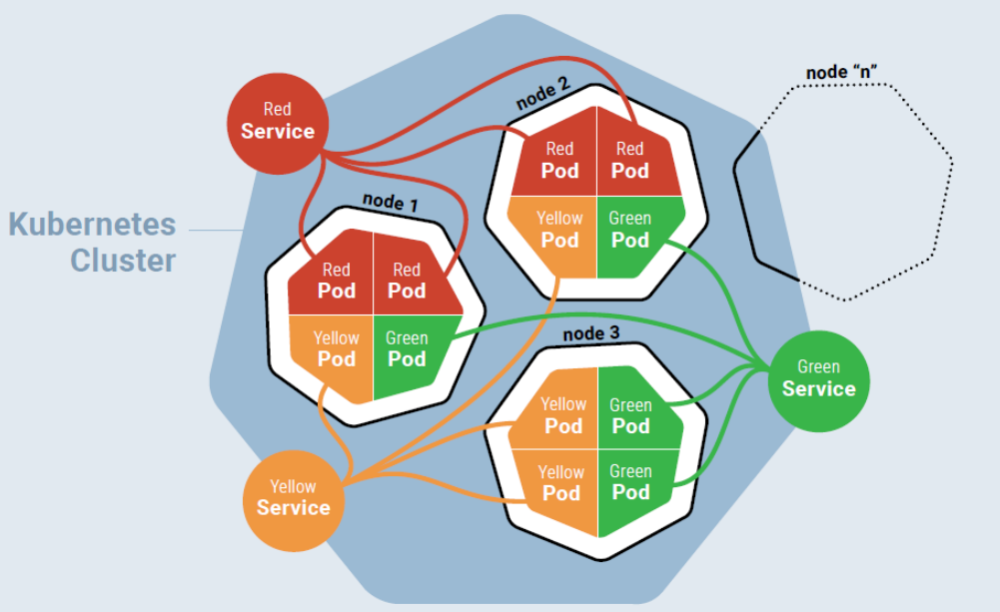
Kubernetes Cluster

Slide 49
Kubernetes - Advantages
Easy organization of service with pods
Largest community among container orchestration tools
Kubernetes can run on-premises bare metal, OpenStack, public clouds Google, Azure, AWS, etc.
Avoid vendor lock issues

